Slide 1

Storage, Settings and Web
4NET
SUPINFO Official Document
Notes:
© SUPINFO International University - http://www.supinfo.com
SUPINFO vous permet de partager ce document
Vous êtes libre de :
Partager — reproduire, distribuer et communiquer ce document Remixer — modifier ce document
A condition de respecter les règles suivantes :
Indication obligatoire de la paternité — Vous devez obligatoirement préciser l’origine « SUPINFO » du document au début de celui-ci de la même manière qu’indiqué par SUPINFO International University – Notamment en laissant obligatoirement la première et la dernière page du document, mais pas d'une manière qui suggérerait que SUPINFO International University vous soutiennent ou approuvent votre utilisation du document, surtout si vous le modifiez. Dans ce dernier cas, il vous faudra obligatoirement supprimer le texte « SUPINFO Official Document » en tête de page et préciser notamment la page indiquant votre identité et les modifications principales apportées.
En dehors de ces dispositions, aucune autre modification de la première et de la dernière page du document n’est autorisée.
NOTE IMPORTANTE : Ce document est mis à disposition selon le contrat CC-BY-NC-SA Creative Commons disponible en ligne http://creativecommons.org/licenses ou par courrier postal à Creative Commons, 171 Second Street, Suite 300, San Francisco, California 94105, USA modifié en ce sens que la première et la dernière page du document ne peuvent être supprimées en cas de reproduction, distribution, communication ou modification. Vous pouvez donc reproduire, remixer, arranger et adapter ce document à des fins non commerciales tant que vous respectez les règles de paternité et que les nouveaux documents sont protégés selon des termes identiques. Les autorisations au-delà du champ de cette licence peuvent être obtenues à support@supinfo.com.
© SUPINFO International University – EDUCINVEST - Rue Ducale, 29 - 1000 Brussels Belgium . www.supinfo.com

Slide 2

Objectives
Storage, Settings and Web
By completing this course, you’ll be able to:
Use Universal Apps Storage to handle file and properties
Allow users to access settings page to confiugure your app
Access web JSON data to display content in your app

Slide 3


Course plan
Storage, Settings and Web
Storage
Settings
Web
Navigation

Slide 4
Storage
Storage, Settings and Web

Slide 5

Storage Facilities
Storage
As your application relies on an operating system, you can use several storage facilities:
Database
Flat file
LocalSettings
This won’t be a course about database access
But we’ll see Flat file and LocalSettings ☺

Slide 6
Flat file
Storage
Universal Apps have a specific class
Windows.Storage.StorageFile
Abstract way to access file in your app easily
Take advantages of async features

Slide 7
Flat file example
Storage
You saw file handling process in many languages!
Open the file
Open the Reader
// using Windows.Storage;
StorageFile sf = await StorageFile.GetFileFromApplicationUriAsync(
new Uri("ms-appx:///Assets/config.txt")
); // ms-appx says "It’s in my solution"
using (StreamReader sr =
new StreamReader(await sf.OpenStreamForReadAsync())) {
// Do it
}
Notes:
Take your time to understand await keywords here. We first wait to access the file, then to open the stream to it

Slide 8
Flat file example
Storage
You saw file handling process in many languages!
Parse the file line by line
Do what you need to do
string line;
while ((line = sr.ReadLine()) != null) {
...
}

Slide 9


Questions?

Slide 10

Exercise (1/2)
Storage
Take your HubApp
In Shared project, Assets folder, create a file « config.txt »
Copy/Paste in this file the following text:
Name:My Config Name
Last-Modified:Two days ago
Shortcut-Close:Alt F4
Shortcut-Open:Ctrl O
Shortcut-SelectAll:Ctrl A
Company:SUPINFO
Purpose:Test Config File

Slide 11
Exercise (2/2)
Storage
Take your HubApp
Open HubPage.xaml
In the fifth section created before, add a Button and set:
x:Name
Text (some label like « Parse file »)
Click
Let Visual Studio offer to you Click event creation
Go to HubPage.xaml.cs
Open the config.txt file
Use breakpoints to be sure you get both properties and valued

Slide 12
Local Settings
Storage
But Universal Apps also take advantage of phones
Especially Local Settings concept
Some Storage for your application
Advantages:
Easy to read and update
Designed to store settings or editable properties
Persistent data even if you close your application!
Disadvantages:
Cannot save complex objects easily (just string, int,…)

Slide 13
Local Settings example
Storage
Still in Windows.Storage namespace
Get local settings
Set properties
Get properties
ApplicationDataContainer localSettings =
ApplicationData.Current.LocalSettings;
localSettings.Values["mysetting"] = "Hello World";
string setting = localSettings.Values["mysetting"] as string;

Slide 14
Questions?

Slide 15
Exercise
Storage
Update your HubApp
Take back your button event where you parse config file
Store each property in localSettings
Create a new Button with a new click event
Check in it localSettings data with breakpoints

Slide 16

Settings
Storage, Settings and Web

Slide 17
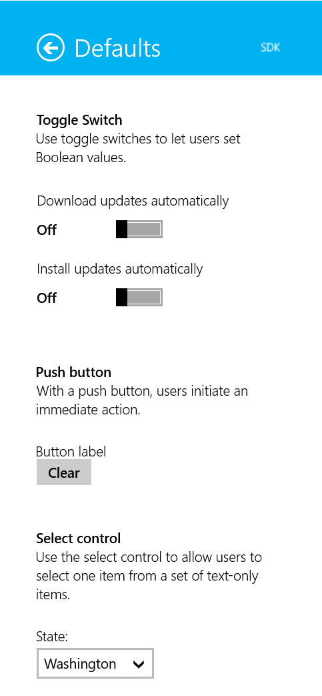
Remember Flyouts?
Settings
Small pieces of UI over your app
Used for warnings, info, controls…
Now we’ll use a SettingsFlyout

Slide 18
SettingsFlyout
Settings
Easily create new SettingsFlyout from Visual Studio
Just plain XAML
With Code Behind for this flyout
Displayable at will!

Slide 19
SettingsFlyout: How to
Settings
Code to display your flyout called MySettingsFlyout
Also handle events:
MySettingsFlyout sf = new MySettingsFlyout();
sf.ShowIndependent();
...
sf.Unloaded += sf_Unloaded;
}
// Launched when flyout disappear (click somewhere else)
private void sf_Unloaded(object sender, RoutedEventArgs args) {
...
}

Slide 20
SettingsFlyout: Example
Settings
In this example, we create a TextBox in our Flyout
Let’s create a getter for the TextBox value
<TextBox x:Name="MyTextBox" />
public string TextBoxValue { get {
return MyTextBox.Text;
} }

Slide 21
SettingsFlyout: Retrieve data
Settings
Then, in the Unloaded event…
And voila!
MySettingsFlyout sf = sender as MySettingsFlyout;
string result = sf.TextBoxValue;

Slide 22
Questions?

Slide 23
Exercise
Settings
Update your HubApp
Add a button to display the Flyout in a HubSection
Create a Settings flyout with three elements:
A TextBox for your name
A Slider from 0 to 10 (number of taken coffee today)
A ToogleSwitch (Do you want more?)
We’ll also add a DateTime property on this Settings flyout
To keep track of last update
Override the Unloaded event
Store all these values in the Local Storage

Slide 24
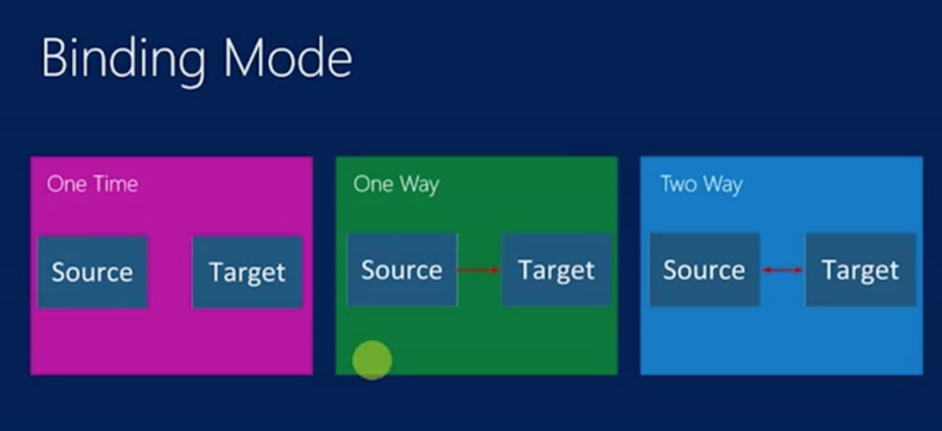
Exercise - Bonus
Settings
Update your HubApp
Create a Grid to display these properties in a HubSection
Use Bindings to display your values
Shouldn’t fail if values are empty!
BINDING PROJECT

Slide 25

Web Access
Storage, Settings and Web
Notes:
Picture from asdfmovie

Slide 26
Introduction
Web Access
Many Universal Apps take advantage of Internet
Gather data and display them
Save preferences, accounts, data in the cloud
Access to everything everywhere
Universal Apps are cool to browse content:
Texts, Pictures applications (newpapers, Tumblr…)
Movies, Music applications (Netflix, Spotify, …)

Slide 27
Universal Devices Connectivity
Web Access
Apps can work on tablets, phones, computers…
Internet isn’t guaranteed!
Always check internet first:
// using Windows.Networking.Connectivity;
public static bool IsInternet() {
ConnectionProfile connections = NetworkInformation.GetInternetConnectionProfile();
bool internet = connections != null &&
connections.GetNetworkConnectivityLevel() ==
NetworkConnectivityLevel.InternetAccess;
return internet;
}

Slide 28
HttpClient
Web Access
Every .NET Web request can pass through HttpClient
No special treatment for Universal Apps
Works for WPF, ASP.NET, Windows Phone, …
Async!
HttpClient client = new HttpClient();
HttpResponseMessage message = await client.GetAsync(new Uri("..."));
string result = await message.Content.ReadAsStringAsync();

Slide 29
Newtonsoft.JSON
Web Access
For this part we’ll need a JSON parser
Newtonsoft.Json is great for this purpose!
Install it from NuGet
Keep in mind it’s not a course about this library
We’ll just use it quickly to get our data
// using Newtonsoft.Json;
// using Newtonsoft.Json.Linq;
JObject obj = JObject.Parse(someJSONdata);
Notes:
We’ll see a quick way to parse JSON data with this library
Note that we can use C# classes to fit with parse, use converters, dynamic and ExpandoObjects, etc… Newtonsoft.JSON is a great lib, but you don’t need to master it to use JSON data in Universal Apps

Slide 30
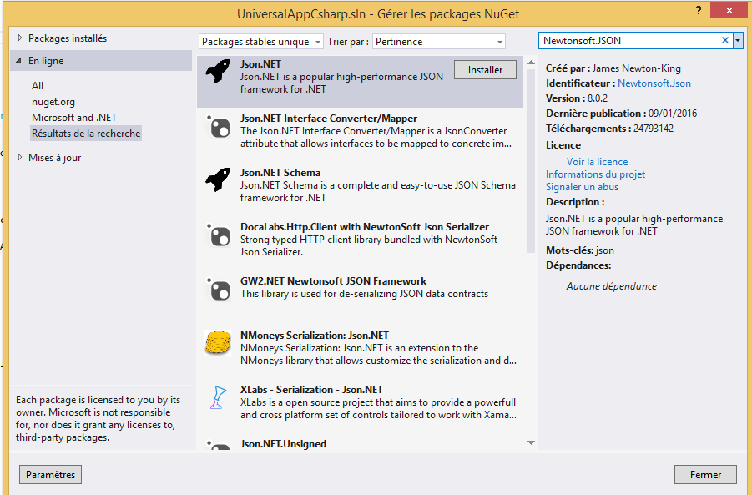
Newtonsoft.JSON
Web Access
Import Newtonsoft.JSON thanks to Nuget package manager
Notes:
We’ll see a quick way to parse JSON data with this library
Note that we can use C# classes to fit with parse, use converters, dynamic and ExpandoObjects, etc… Newtonsoft.JSON is a great lib, but you don’t need to master it to use JSON data in Universal Apps

Slide 31
Newtonsoft.JSON JProperty
Web Access
Facts:
JObject represents a JSON Object
JProperty represents a JSON Property
Process:
After parsing, we get a JObject
Iterate through it to get JProperty objects

Slide 32
Newtonsoft.JSON JProperty
Web Access
JSON complete code sample:
// using Newtonsoft.Json;
// using Newtonsoft.Json.Linq;
JObject obj = JObject.Parse(someJSONdata);
foreach (JProperty prop in obj.Properties())
{
switch (prop.Name)
{
...
}
}
Best method ->
Generate set of C# classes which represent JSON object response (http://json2csharp.com/#)
Use : JsonConvert.DeserializedObject<RootObject>
(json);

Slide 33
Questions?

Slide 34
Exercise
Web Access
Update your HubApp
Add a button to generate a web request to Flickr API URL
URL available in comments
Add the « async » keyword on the Button event method
Parse this data with Jproperty (check with breakpoints)
Display data in your application
If you have time left, use BitmapImage to display pictures!
Notes:
http://api.flickr.com/services/feeds/photos_public.gne?format=json&nojsoncallback=1

Slide 35

Navigation
Storage, Settings and Web

Slide 36
Introduction
Navigation
We didn’t show any way to navigate through pages yet
Of course, it’s useful to dive into content
Navigation is really easy in Universal Apps
Any XAML Page extends from Page
Gives access to the Frame property
Handles navigation

Slide 37
How to: Navigate
Navigation
Navigate method, 3 parameters, 1 mandatory:
Frame.Navigate(
Type page,
object parameter,
NavigationTransitionInfo animation
);
Last parameter is used to override default animation
Linked to your XAML ☺

Slide 38
Example navigation
Navigation
Go to Page2:
With arguments:
void MyButton_ItemClick(object sender, RoutedEventArgs e) {
this.Frame.Navigate(typeof(Page2));
}
void ItemView_ItemClick(object sender, ItemClickEventArgs e)
{
var itemId = ((SampleDataItem)e.ClickedItem).UniqueId;
this.Frame.Navigate(typeof(ItemPage), itemId);
}
Notes:
Note that SampleDataItem and UniqueId are custom classes used on HubApp example application.
Tranks to bindings, we map each item to objects of type SampleDataItem and get their UniqueId, which make this code work.

Slide 39
Example navigation
Navigation
Get parameter on ItemPage:
override void OnNaviguateTo(NaviguationEventArgs e)
{
int itemId = e.Parameter as int;
}

Slide 40
Example navigation with animations
Navigation
In XAML, property Page.Transitions
Contains a transition collection
Each of them are merged in you specify several
Example:
With arguments:
<Page.Transitions>
<TransitionCollection>
<ContentThemeTransition HorizontalOffset="1000"/>
</TransitionCollection>
</Page.Transitions>
Notes:
We have many transitions and you can even create your own with storyboards.
It sure is interesting but default transitions keeps the user in a known environment. For the sake of UX, be careful with awkwards transitions.

Slide 41
Questions?

Slide 42
Exercise 1/2
Navigation
Create a new Empty Application
Create a Song class:
string Name
string Album
Create a MusicGroup class:
int UniqueId
string Name
int GroupMembers
One List of Songs

Slide 43
Exercise 2/2
Navigation
Create a new Empty Application
Create a MusicRepository class:
Should populate and serve some data
At least four MusicGroups
Each of them having at least two songs
Bind a ListView with your Repository data
Should display on your application your group names
Click on a ListItem should navigate to a second page
Display song lists and related albums

Slide 44

The End
Storage, Settings and Web
That’s all folks!

